Slide 1
Introduction to Computer Vision
Harish Kashyap, AI Instructor, Caltech CTME

Slide 2
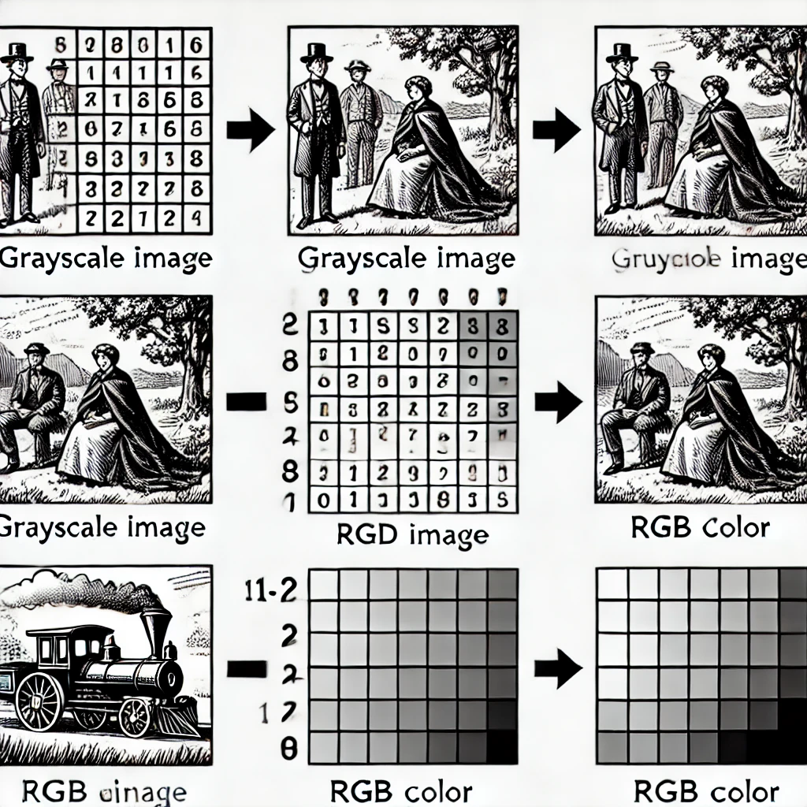
Introduction to Computer Vision
Representation of an Image as a 2D Matrix
Digital images are represented as 2D matrices of pixel values.
Each pixel holds intensity (grayscale) or color information (RGB values).
Matrices are processed for tasks like edge detection, object recognition, etc.

Slide 3
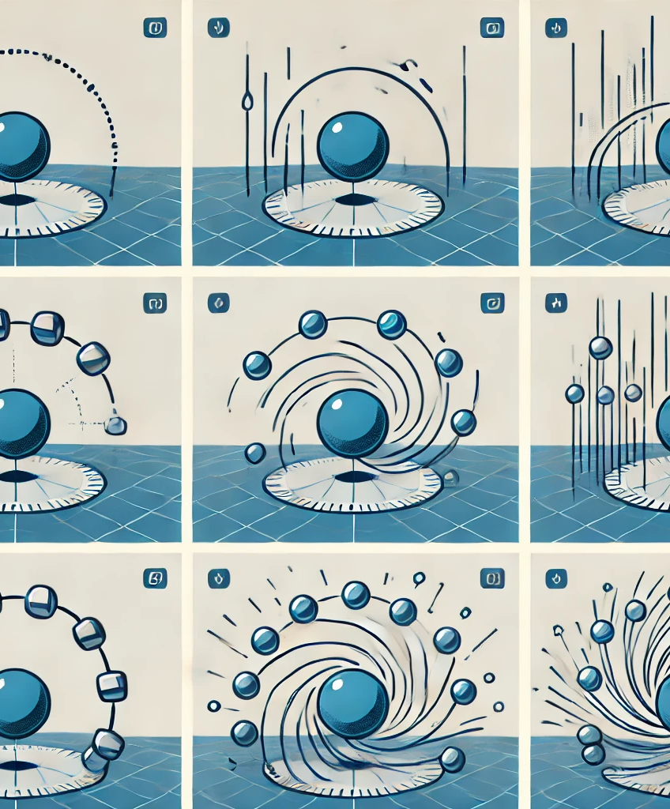
Videos as a Set of Image Frames
Videos are sequences of images (frames) displayed in rapid succession.
- Frame rate (FPS) affects the smoothness of motion.
- Each frame is an individual image processed during computer vision tasks like action recognition.
- short sequence showing frames of a moving object.

Slide 4
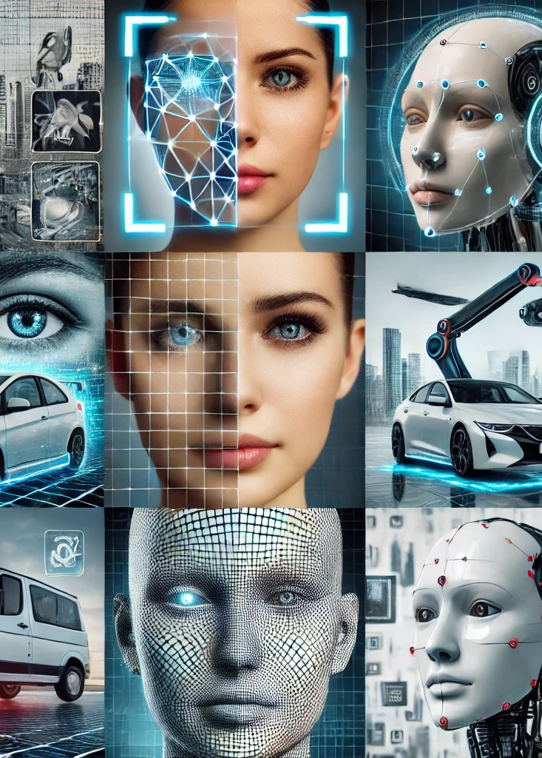
Introduction to Computer Vision and Its Applications
A field of AI enabling machines to interpret and process visual data (images and videos).
Applications : Face recognition
Object detection and tracking
Medical imaging (X-rays, MRI)
Autonomous vehicles
Industrial automation

Slide 5
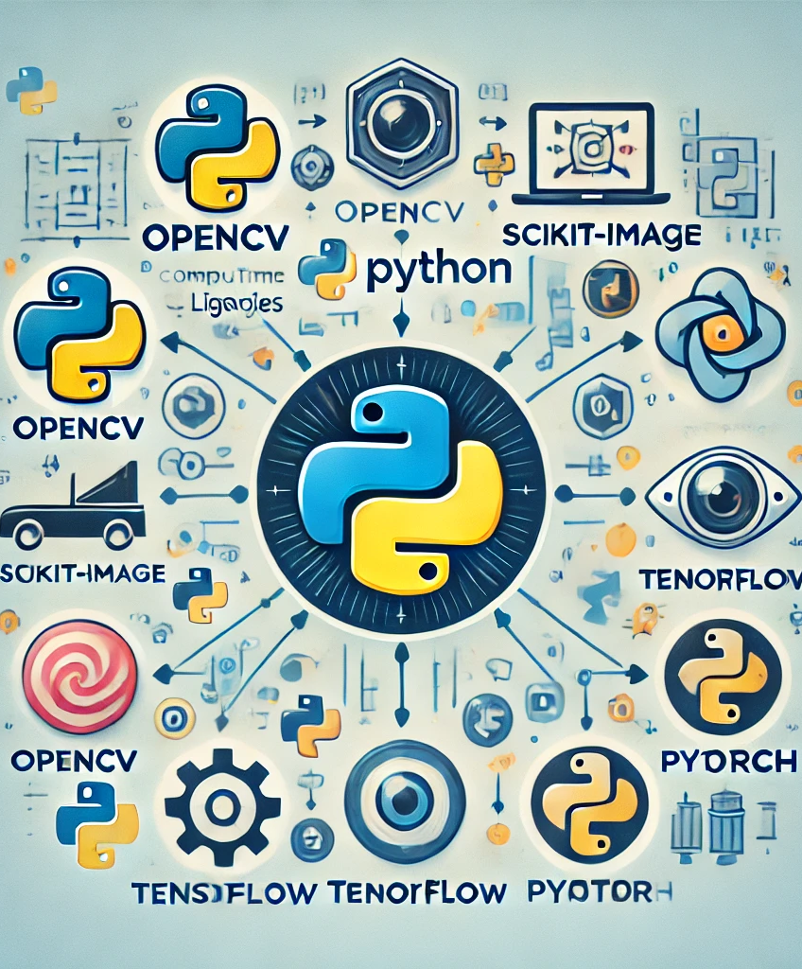
Overview of Python and Its Libraries for Computer Vision
Why Python for Computer Vision?
Easy to learn,
robust libraries,
and active community.
Popular Libraries:
OpenCV: Real-time computer vision.
scikit-image: Image processing in Python.
TensorFlow and PyTorch (for deep learning applications).

Slide 6
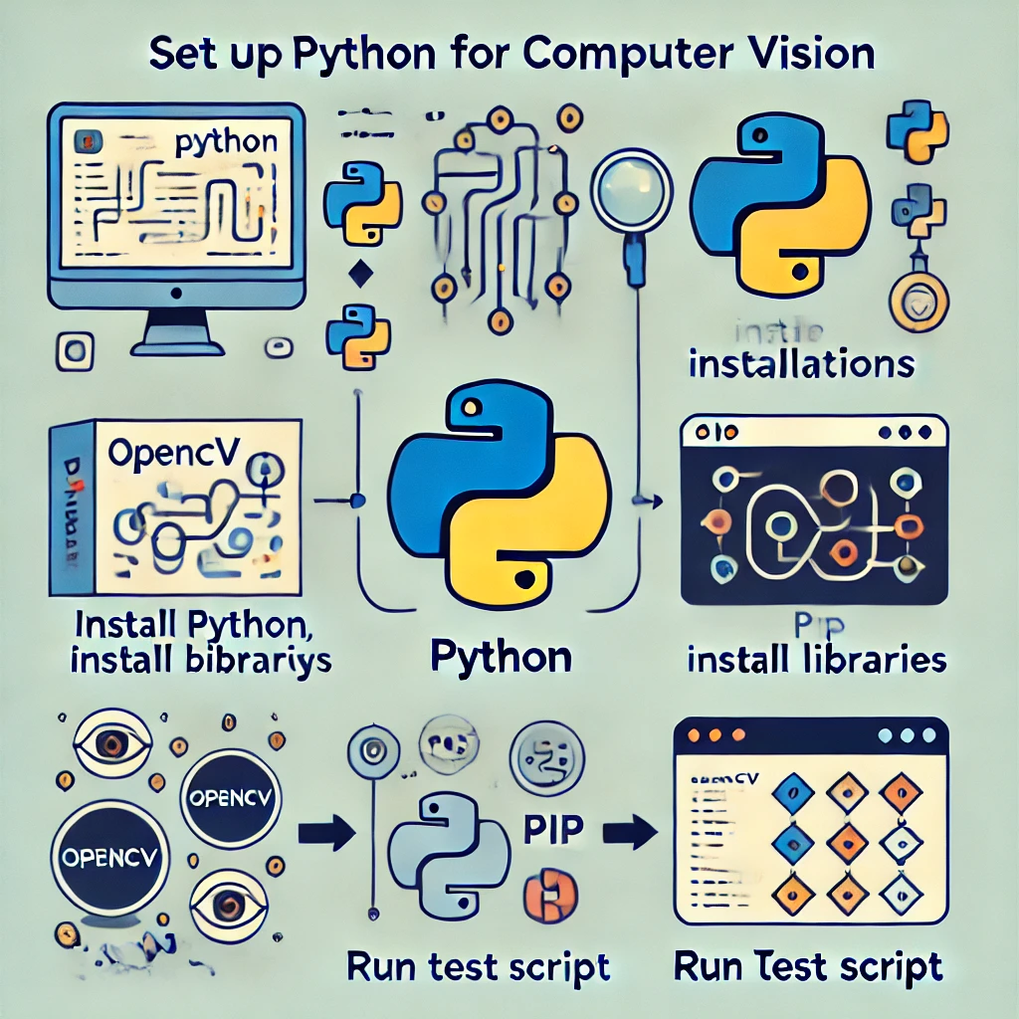
Setting Up Python and Necessary Libraries

